Slide 1
Test Types
Efficient sticky notes
Andrii Artysh
January 2016

Slide 2
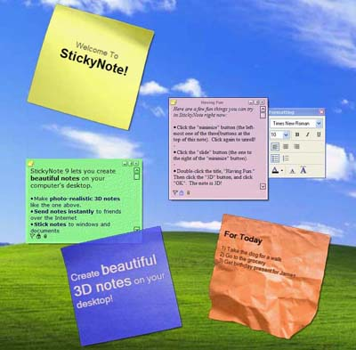
Object for testing:
Efficient sticky notes

Slide 3

Agenda
Smoke testing
Functional testing
Non-functional testing: UI
Positive testing
Negative testing
Localization testing
Internationalization testing

Slide 4

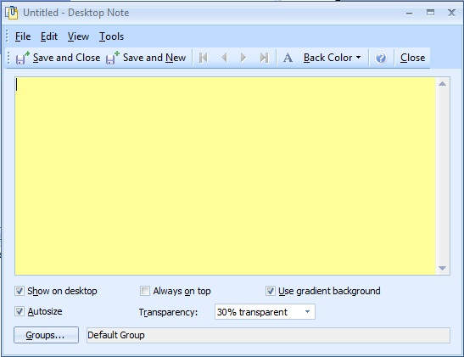
Smoke testing
Requirement: User can create a new Desktop Note.
Smoke Testing Procedure:
1. Press Windows
2. Find and open Efficient Sticky Notes
3. Press
Expected result:
The Page is open.
User can create new
Desktop Note.

Slide 5
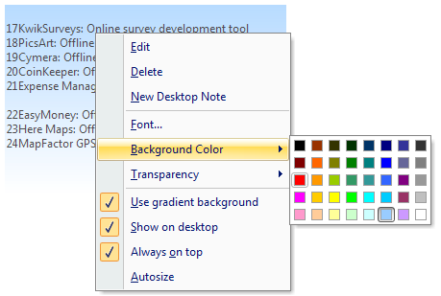
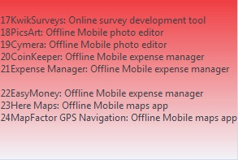
Functional testing
Requirement: User can to change background color.
Functional Testing Procedure:
1. Press right mouse button on Desktop Stick
2. In menu select “Background Color”
3. Select color
Expected result:
Background color is change.

Slide 6
Non-functional testing: UI
Requirements: Program menu with icons must located in the top . Menu icons should be clear to read and separated from each other.
UI Testing Procedure:
1. Open Efficient Sticky Notes
2. Observe the menu
Expected result:
The Program menu with icons is located in the top of the main page. All menu icons are clear to read and separated from each other.

Slide 7

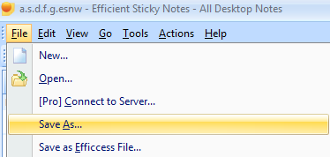
Positive testing
Requirement: User can save Desktop note used
unique name
Positive Testing Procedure:
1. Press Windows
2. Find and open Efficient Sticky Notes
3. Press File – Save As…
4. Chose unique name
“aartytc”
5. Press “Save” button
Expected result:
User save new Desktop note
with unique name.

Slide 8
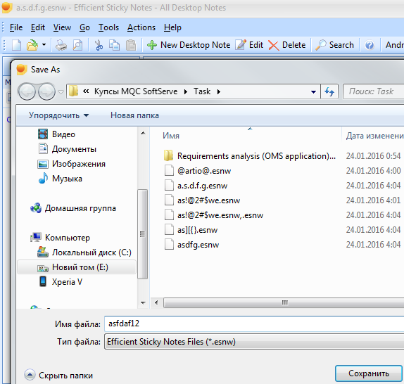
Result

Slide 9
Negative testing
Requirement: User can save Desktop note with special characters
Negative Testing Procedure:
1. Press Windows
2. Find and open Efficient Sticky Notes
3. Press File – Save As…
4. Chose unique name
a_a!r#ty|t\c
5. Press “Save” button
Expected result:
User can not save new Desktop note
with some special characters.

Slide 10
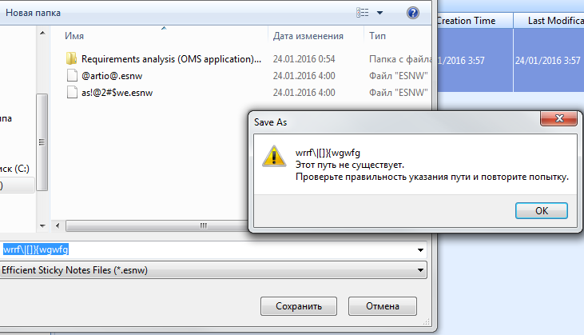
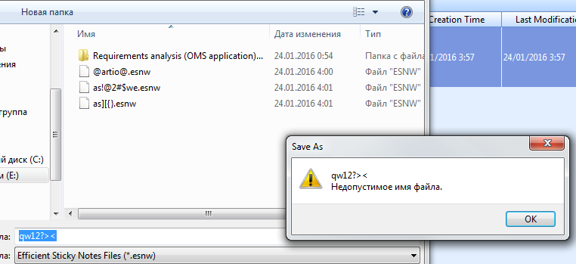
Result

Slide 11

Localization testing
Requirement: Program translate all textual information when user change a language .
Localization Testing Procedure:
1. Press Windows
2. Find and open Efficient Sticky Notes
3. Press Tools – Language - русский
4. Check all textual information
Expected result:
Program translate all textual
information correct

Slide 12
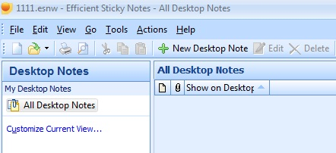
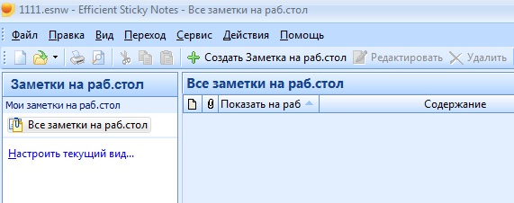
Result

Slide 13

Internationalization testing
Requirement: Program should correctly displays hiragana, katakana characters including kanji.
Localization Testing Procedure:
1. Press Windows
2. Find and open Efficient Sticky Notes
3. Press
4. Enter Japanese language text
Expected result:
Program correctly displays
hiragana, katakana characters
and kanji

Slide 14
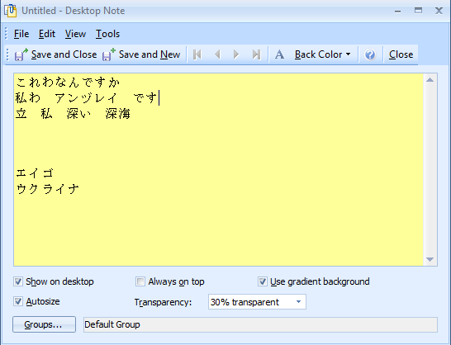
Result

Slide 15
Thank you

